Slide 1
Learning Maps, Common IDs and the Common Core
Maureen Wentworth Council of Chief State School Officers
Michael Jay Educational Systemics Association of Educational Publishers
Sharren Bates Bill & Melinda Gates Foundation
Brandt Redd Bill & Melinda Gates Foundation

Slide 2
CCSS The Common Core State Standards provide a consistent, clear understanding of what students are expected to learn
LRMI The Learning Resource Metadata Initiative is a standard way to tag learning content to make it easier to find. This includes alignment to standards like the CCSS.
Learning Maps Are a logical and visual way for students and educators to engage directly with core standards and find corresponding learning resources

Slide 3

The Common Core State Standards Maureen Wentworth Program Director, Education Data and Information Systems Council of Chief State School Officers

Slide 4
Why Common Standards?
Consistency
Previously, every state had its own set of academic standards and different expectations of student performance.
Equity
Common standards can help create more equal access to an excellent education.
Economic Opportunity
All students must be prepared to compete with not only their American peers, but also with students from around the world.
Clarity
Clear and coherent standards will help students (and parents and teachers) understand what is expected of them.
Collaboration
Common standards create a foundation for districts and states to work collaboratively.

Slide 5
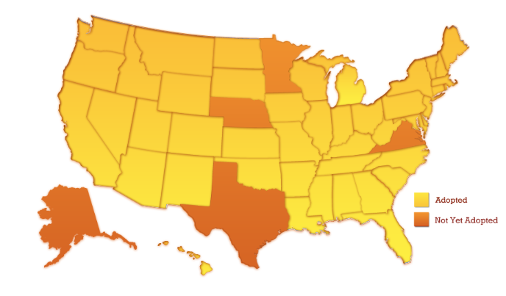
Common Core State Standards Adoption

Slide 6

English Language Arts (ELA) Shifts
What Students Read
Emphasis on non-fiction
Attention to text complexity
Evidence
Reading and writing are grounded in evidence from the text
Academic Vocabulary
Regular practice with vocabulary like “synthesize” and “correspond”

Slide 7

Math Shifts
Focus
2-4 concepts focused on deeply in each grade
Coherence
Concepts logically connected from one grade to the next and linked to other major topics within the grade
Rigor
Fluency with arithmetic, application of knowledge to real world situations, and deep understanding of mathematical concepts

Slide 8
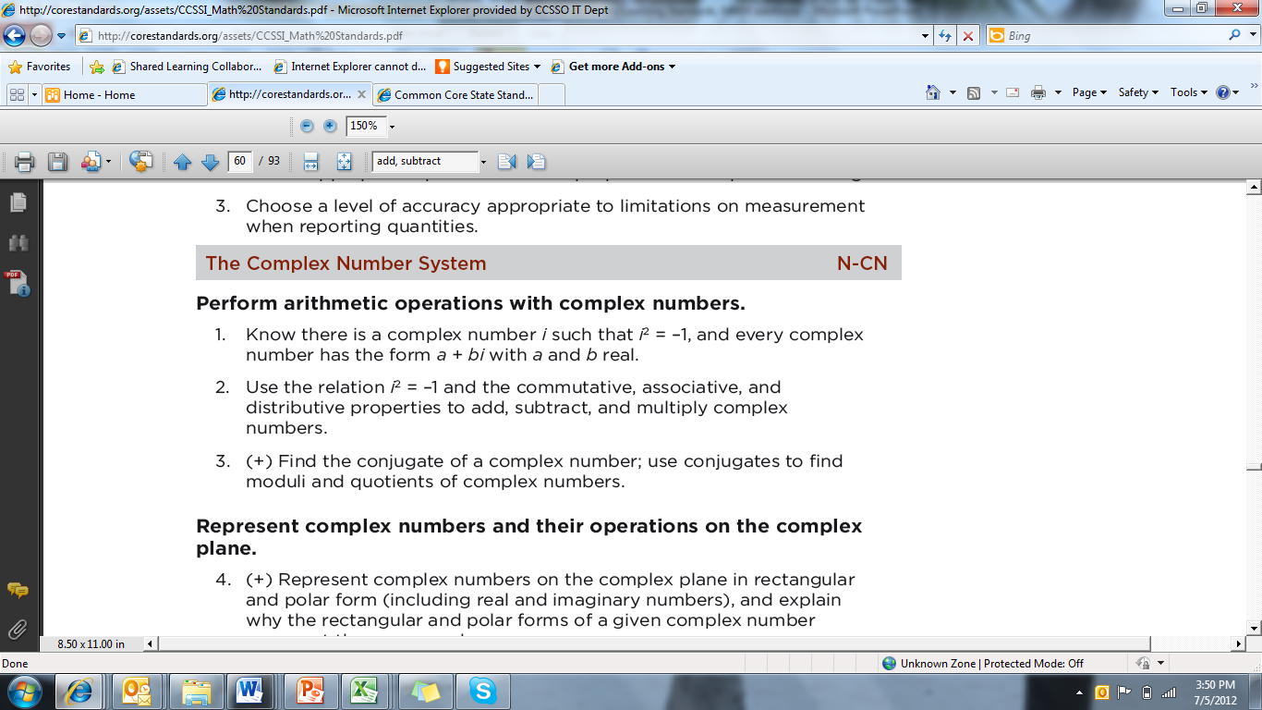
Anatomy of a Standard
The Domain
The Standard
The Cluster

Slide 9






www.lrmi.net
Education Metadata
for
Quality Search & Discovery
iNACOL VSS – 22 October 2012
9

Slide 10
WHO IS THE LRMI?
Leadership
The Association of Educational Publishers
Creative Commons
Contributing Organizations
Full Potential Associates
Educational Systemics, Inc.
Agilix Labs
Knovation
Funding
Bill & Melinda Gates Foundation
William and Flora Hewlett Foundation
Participating Publishers!
10
Notes:
DAVE
AEP and CC were invited by BMGF to co-lead Phase I of the initiative in 2011 (technical work, development of framework)
AEP was invited to facilitate Phase II—adoption and implementation—in 2012, focusing more on content development community, working at this point with these organizations.

Slide 11
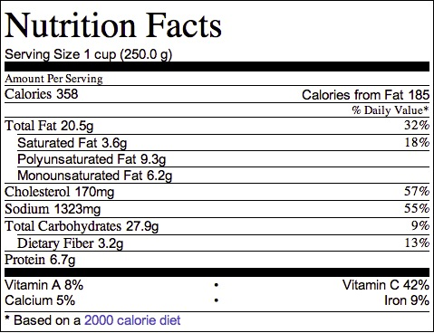
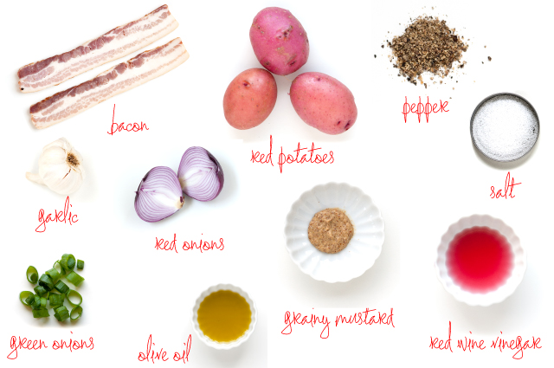
So, why do we need a standard?
Ingredients vs.
Nutritional Facts
11

Slide 12

Metadata is “Data About Data”
Data
It was the best of times, it was the worst of times, it was the age of wisdom, it was the age of foolishness, it was the epoch of belief, it was the epoch of incredulity, it was the season of Light…
Metadata
Title: A Tale of Two Cities
Author: Charles Dickens
Publication Date: 1859
Pages: 400
12

Slide 13
So What? We Already Use…
IEEE LOM
Dublin Core Metadata
SCORM
Proprietary metadata schema
13

Slide 14
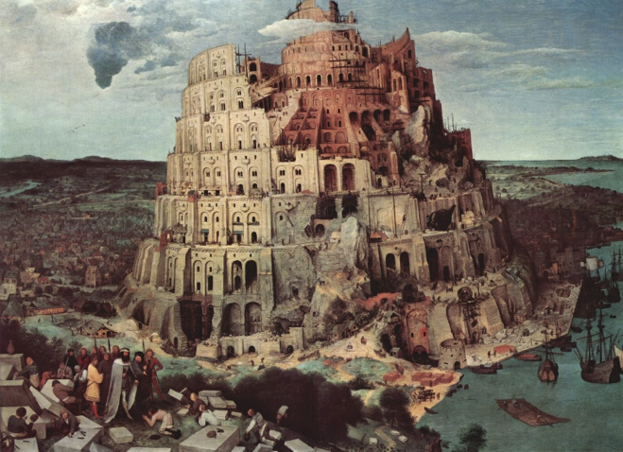
So why is this effort different?
We need a common set of descriptors that allow us to structure our searches.
Common is not so common!
Education benefits from not going it alone… even with the trade-offs.
We have lived in a world with different standards. The internet changes all that.
This is an international initiative.
THE TOWER OF BABEL, PIETER BRUEGEL, 1563
14

Slide 15
The Learning Resource Metadata Initiative (LRMI)
Goal: Make it easier and more convenient to find learning resources that meet specific student and class needs.
Curriculum Standards
Intersection of three opportunities
LRMI
Schema.org
Resource Registries
(Learning Registry)
15
Notes:
Goal
Make it easier and more convenient to find learning resources that meet specific student and class needs.
Intersection of three opportunities
Adoption of the Common Core State Standards by 45 States, DC and 3 Territories (http://corestandards.org)
Schema.org joint initiative by Google, Yahoo and Microsoft Bing (http://schema.org)
Advent of the Learning Registry (http://learningregistry.org)
Informed by previous education and metadata efforts
IEEE LOM
Dublin Core
SCORM
Many others

Slide 16

What is the Process?
2. Publish
Tagger output is
pushed to The Learning Registry and embedded in your page(s) to make your content much more easily
discoverable.
1. Tag
3. Search
Your content tagged
with LRMI metadata is more easily discovered, accessed and purchased.
Use the Open Source Tagger to create LRMI metadata for your educational resources.
Your Data
Resource Registry
16

Slide 17
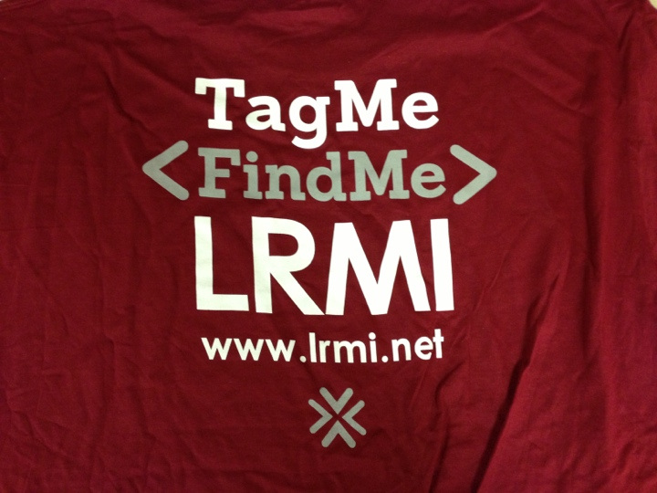
What is the Process?
17

Slide 18
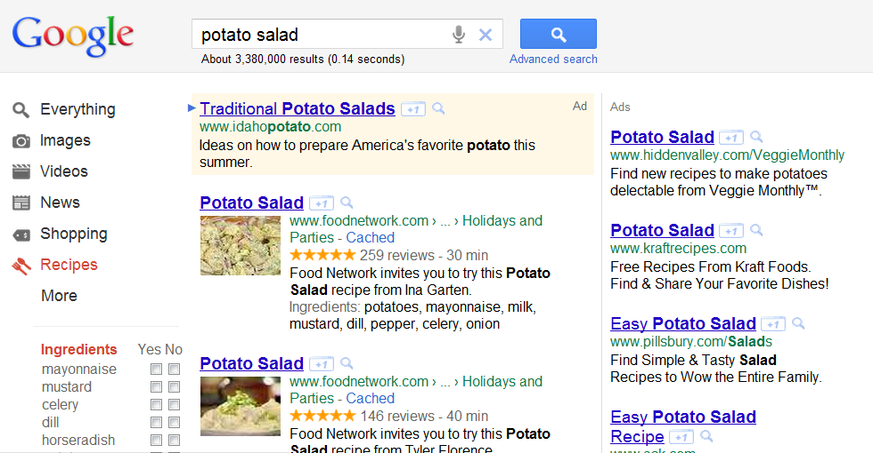
LRMI Enables Better Search (Schema.org)
18

Slide 19
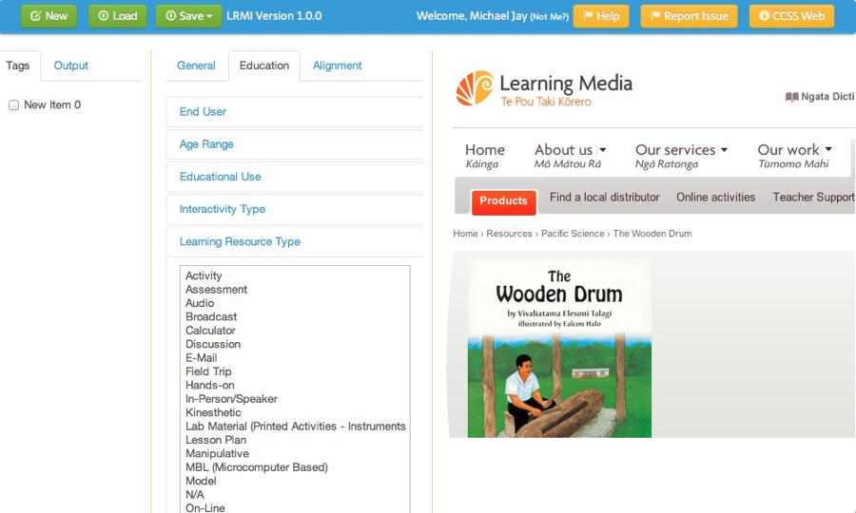
Open Source Tagger
19

Slide 20
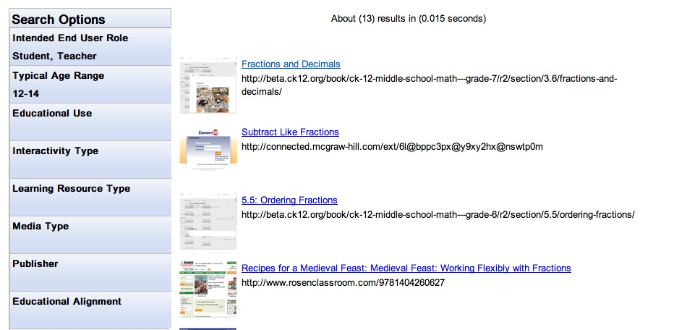
LRMI Enables Better Search (Registry)
20

Slide 21
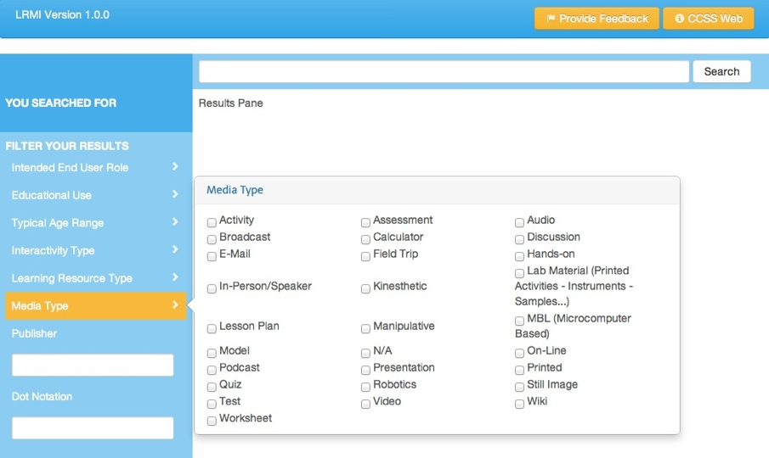
LRMI Enables Better Search (Registry - New)
21

Slide 22
What does the LRMI enable?
Search...
Integrated Search
Find instructional resources to address curriculum standards
Determine which standards are addressed by a collection of instructional resources
Personalized learning
Individualized learning
… much more!
22

Slide 23
The LRMI Properties v1 (lrmi.net/the-specification)
General Terms:
title/name
URL
Description
Image
Topic
created (date)
Creator
Publisher
inLanguage
Mediatype
technologiesRequired
technologiesRecommended
Use RightsURL
is based on
Educational Terms:
intendedEndUserRole
educationalUse
timeRequired
typicalAgeRange
interactivityType
learningResourceType
Competency related:
educationalAlignment
Description
URL
Alignment Type
educationalFramework
targetDescription
targetName
targetURL
23

Slide 24
Look at one property
Learning Resource Type
Schema.org practice is to have community use define values
We have created some recommended values:
Activity
Audio
Broadcast
Calculator
Discussion
E-Mail
Field Trip
Hands-on
In-Person/Speaker
Kinesthetic
Lab Material
Manipulative
MBL
Model
On-Line
Podcast Presentation
Printed
Robotics
Still Image
Video
Wiki
Worksheet
Lesson Plan
Test
Quiz
24

Slide 25
Phase II: Adoption/Implementation March 2012 – February 2013
Awareness building
Proof of Concept
Collaboration on Tagger/Search
Educator/publisher surveys
Encouraging/supporting Schema.org adoption
25
Notes:
With publication of 1.0 focus has shifted to building awareness in education community – mailing list of over 400
Webinars, industry events (MDL at CIC, ISTE, EdNET, Frankfurt, proposal in for TOC)
Proof of Concept - How does it work? What does it take for publishers to begin tagging to LRMI
Actively engaged with about 50 publishers, over 600 resources tagged, 450 more in the queue
Documenting best practices
Tagger/Search – working closely w/Agilix, contracted by Gates to build open source application to enable easy tagging – early release due soon
Also working to develop a search app that will filter using LRMI tags
Surveys
gauge educators’ attitudes toward and needs for search
gauge publishers’ awareness and attitudes toward LRMI and satisfaction with current online visbility
Results available on LRMI.net
Offered to send findings to Schema.org via Greg in hopes it will impact how quickly and in what ways search engines begin to incorporate LRMI in search

Slide 26
PoC Round One Participants
Better Lesson
CK-12
Houghton Mifflin Harcourt
Learning.com
Learning Station
McGraw-Hill
Pearson
PCI Educational Publishing
Rosen
26

Slide 27
PoC Round Two Participants
22 actively pursuing Phase II
700+ resources already submitted for Phase II
36 new publishers engaged in Phase II
27

Slide 28
For more Information on LRMI
Michael Jay
michael@edusystemics.com
Teila Evans, Project Manager
teila@edusystemics.com
28

Slide 29
Learning Maps Authoring Tools and the Common Core
Sharren Bates

Slide 30
Learning Maps Authoring Tools
Learning Maps Authoring Tools offer easy-to-use content standards browsing and provide baseline functionality to kickstart innovation in data reporting interfaces and recommendation engines.
SLC will provide a Learning Map Authoring Tool for users to customize and publish their own path through the Common Core or to build new taxonomies for additional subjects.
The authoring tool will allow users to store paths and generate new visualizations.
Learning Maps Authoring Tool
Learning Maps Data Store
Learning Map Visualizations

Slide 31
Common Core Navigator
Pre-Loaded with the Common Core state standards as published on corestandards.org
Curriculum and Instruction teams can decide who they’d want to access an editing and publishing tool
Future versions of the software will include authoring standards for different subjects
Future versions of the software will allow users to login and save standards/paths or use standards/paths other have saved.

Slide 32
Visualizations
Load points on the map from Common Core standards that have been stored as data
Loads paths based on the paths users create in the Path Builder tool
Will connect to SLC’s LRI and search app when they are available
SLC is investing in example visualizations and welcome additional great visualizations from the field.

Slide 33
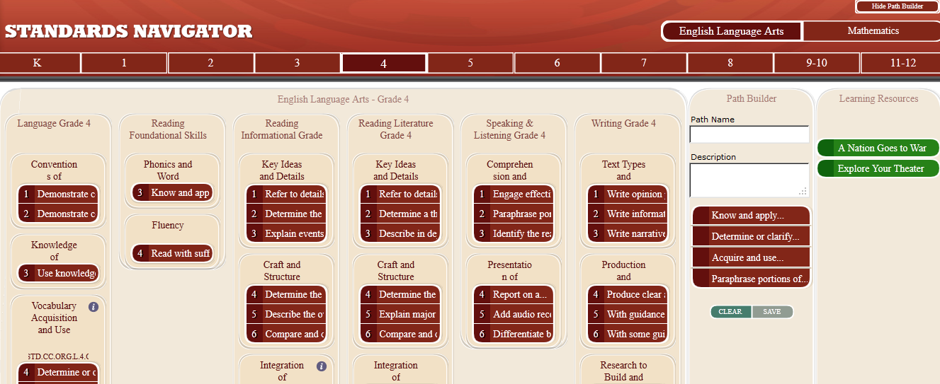
Navigating Standards and Creating Paths

Slide 34
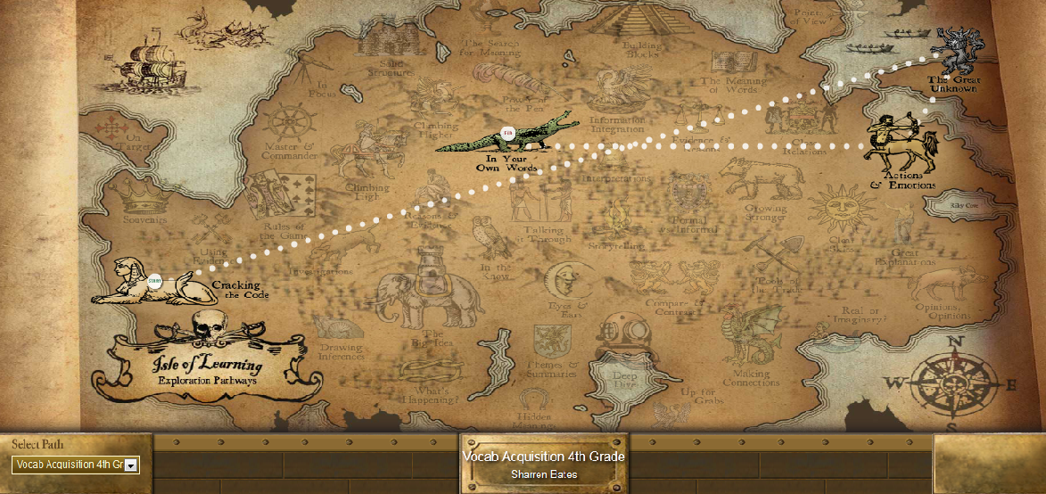
Creating Visualizations for Elementary School

Slide 35

Creating Visualizations for High School Students

Slide 36
High-Value Instructional Use Cases
Publish Learning Maps to support teachers’ understanding of the Common Core
Publish Learning Maps to support teachers and students implementing CCSS-aligned Scope and Sequence
Publish Learning Maps to support curriculum development in non-CCSS subjects
Build reporting and curriculum systems that re-purpose the base code to draw connections between student data and available content

Slide 37
High-Value Technology Uses
Use the same standards in curriculum/content tagging and student achievement data to build connections between data and content
Require content providers to align to your scope and sequence and other instructional priorities through automated connections to learning map metadata

Slide 38
Q & A
Resources
http://www.corestandards.org Common Core State Standards
http://lrmi.net Learning Resource Metadata Initiative teila@edusystemics.com
http://learningregistry.org The Learning Registry
http://www.slcedu.org The Shared Learning Collaborative

